Slide 1

Data Structures
Lecture 8: Recursion

Slide 2

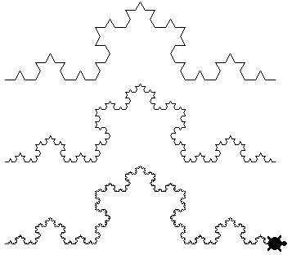
Recursion
A programming technique in which a method (function) calls itself.
Computer scientists use recursion to solve problems in the field of artificial intelligence (AI) often such as chess, proving mathematical theorems, recognizing patterns, and so on.
Recursion can generate simple solutions to certain kinds of problems that would be difficult to solve in other ways.

Slide 3
Example: Triangular Numbers (1)
Not in the book
n=1, number=1
n=2, number=3
n=3, number=6
n=4, number=10
n=5, number=15

Slide 4
Example: Triangular Numbers - Iterative
Not in the book
int triangle(int n){
int sum=0;
while(n>0){
sum+= n;
--n;
}
return sum;
}

Slide 5
Example: Triangular Numbers – Recursive (1)
Not in the book
Recursive thinking:
(1) Find the tallest column, which has the value of n.
(2) Add the sum of all the remaining elements
n=1, number=1
n=2, number=3
n=3, number=6
n=4, number=10
n=5, number=15

Slide 6
Example: Triangular Numbers – Recursive (2)
Not in the book
int triangle(int n){
return (n +sumRemainingColumns(n));
}
int triangle(int n){
return (n +sumAllColumns(n-1));
}
i=1, number=1
Infinite loop
i=2, number=3
int triangle(int n){
return (n +triangle(n-1));
}
i=3, number=6
i=4, number=10
i=5, number=15
Notes:
Implementing recursive thinking in different ways

Slide 7
Example: Triangular Numbers – Recursive (3)
Not in the book
int triangle(int i){
if(n==1)
return 1;
return (n +triangle(n-1));
}
base case
i=1, number=1
i=2, number=3
i=3, number=6
i=4, number=10
i=5, number=15
Notes:
Implementing recursive thinking in different ways

Slide 8
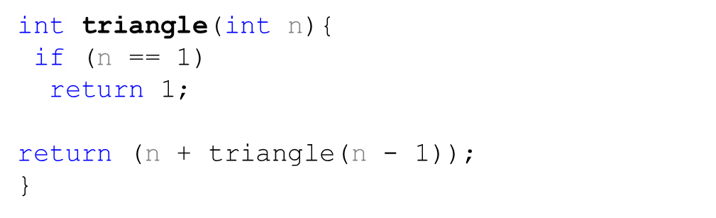
Example: Triangular Numbers – Call Stack
Not in the book
triangle(3)
return 3 + triangle(2)
3
triangle(4)
triangle(2)
1
6
return 2 + triangle(1)
return 4 + triangle(3)
triangle(1)
triangle(5)
return 1
int :1
return address in triangle(2)
10
return 5 + triangle(4)
int : 2
return address in triangle(3)
15
int : 3
return address in triangle(4)
int : 4
return address in triangle(5)
int : 5
return address in caller
Activation frame
Notes:
Implementing recursive thinking in different ways

Slide 9
Efficiency of Recursion
Recursive method often slower than iterative; why?
  Overhead for loop repetition smaller than
  Overhead for call and return
If easier to develop algorithm using recursion,
  Then code it as a recursive method:
  Software engineering benefit probably outweighs ...
  Reduction in efficiency
Don’t “optimize” prematurely!

Slide 10
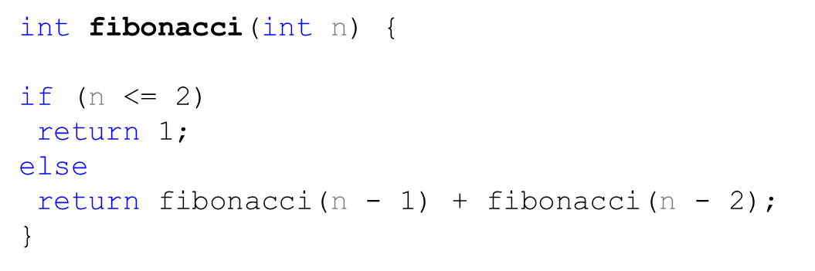



Fibonacci numbers (1)
5
fibonacci(5)
3
2
fibonacci(4)
fibonacci(3)
2
1
1
1
fibonacci(3)
fibonacci(2)
fibonacci(2)
fibonacci(1)
1
1
fibonacci(2)
fibonacci(1)

Slide 11
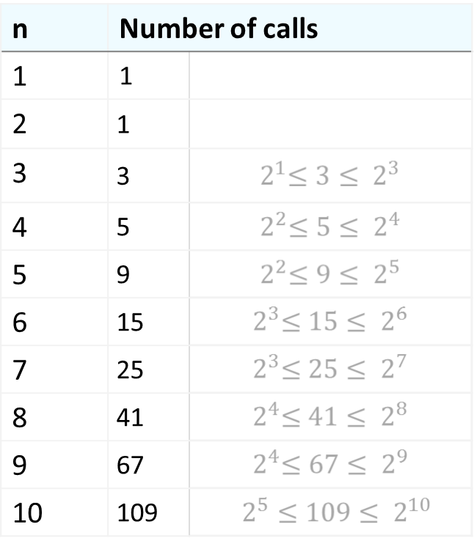
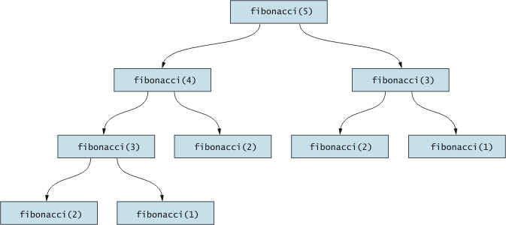

Fibonacci numbers (2)

Slide 12


Task
Not in the book
Write an efficient iterative function that calculates the Fibonacci for a given number.
(n)

Slide 13
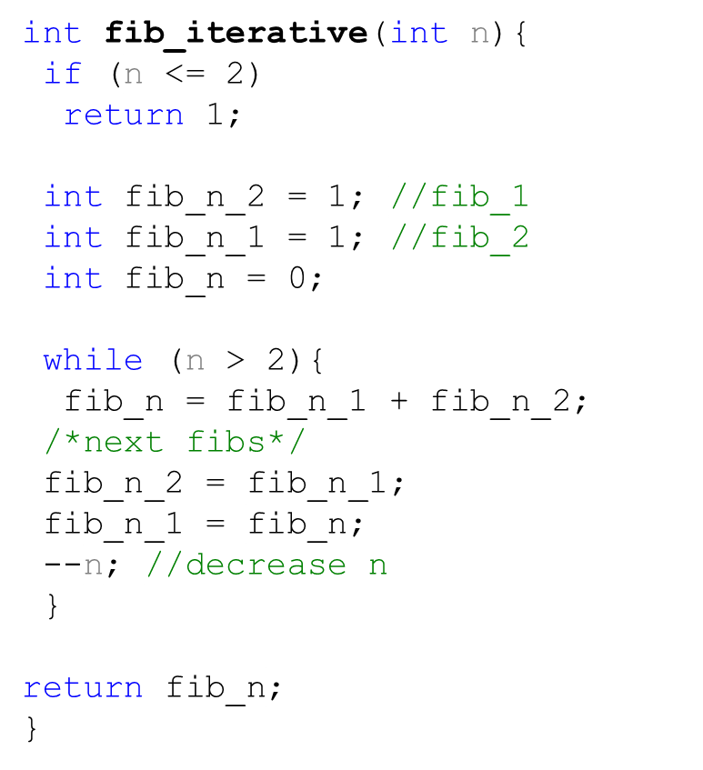
Solution
Not in the book
Fib_n | Fib_n_1 | Fib_n_2 | n
0 | 1 | 1 | 5
2 | 2 | 1 | 4
3 | 3 | 2 | 3
5 | 5 | 3 | 2
(n)

Slide 14
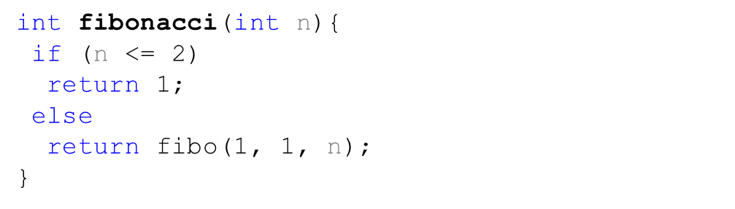
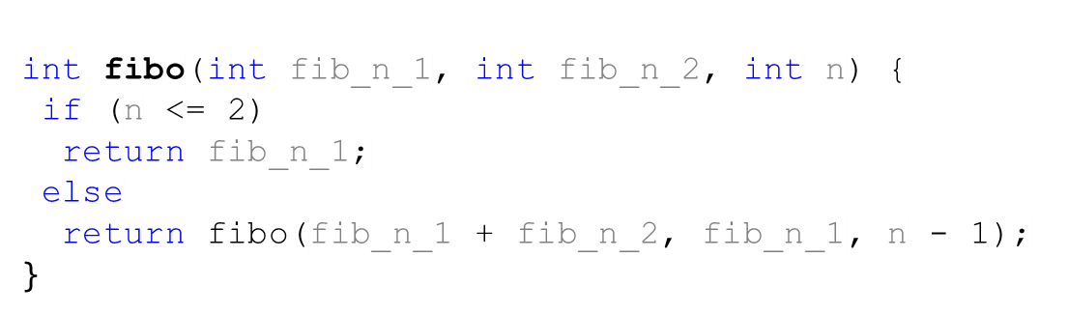
A Better Recursive Fibonacci
Not in the book
Wrapper function
Function | Fib_n_1 | Fib_n_2 | n
fibo(1,1,5) | 1 | 1 | 5
fibo(2,1,4) | 2 | 1 | 4
fibo(3,2,3) | 3 | 2 | 3
fibo(5,3,2) | 5 | 3 | 2
(n)
Big O

Slide 15
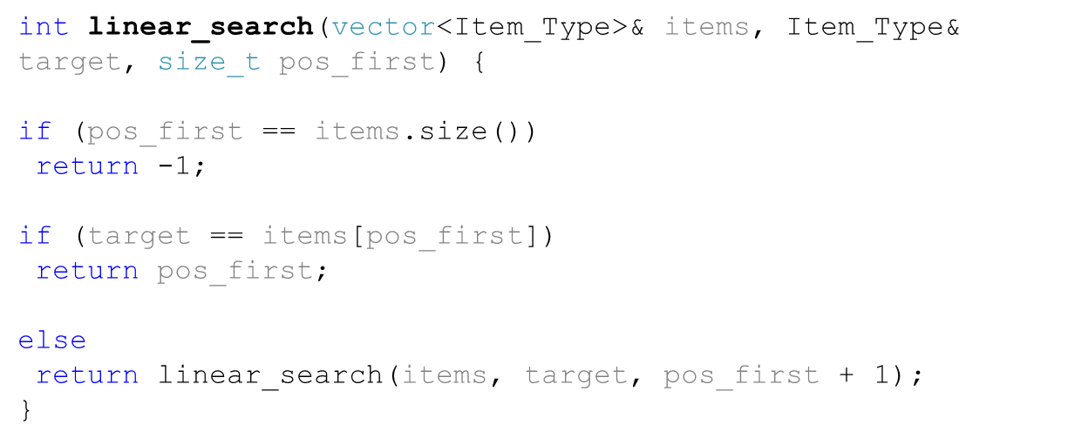
Recursive Linear Search
How to search a vector recursively?
Empty vector
One item
A
Otherwise
A
B
C

Slide 16
Task
Not in the book
Using recursion, write a function that calculates the average of a list of integers.
Use an iterator as well.
Write a wrapper function as well.

Slide 17
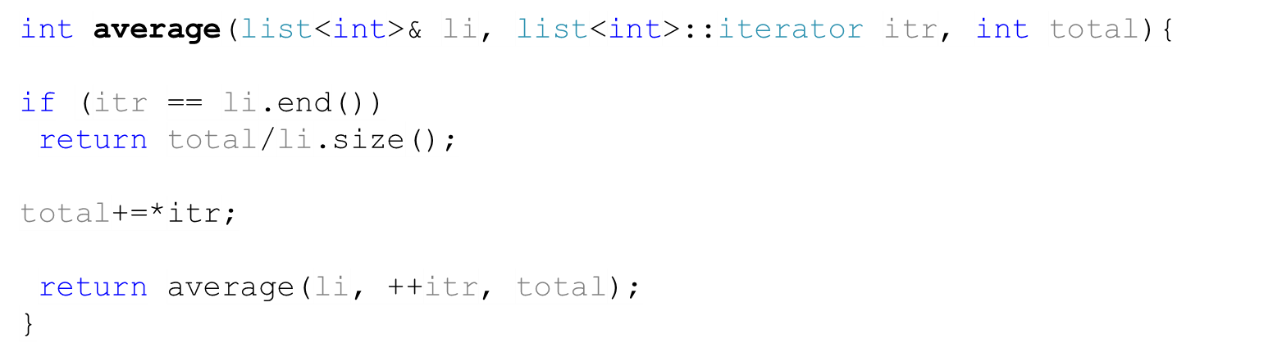


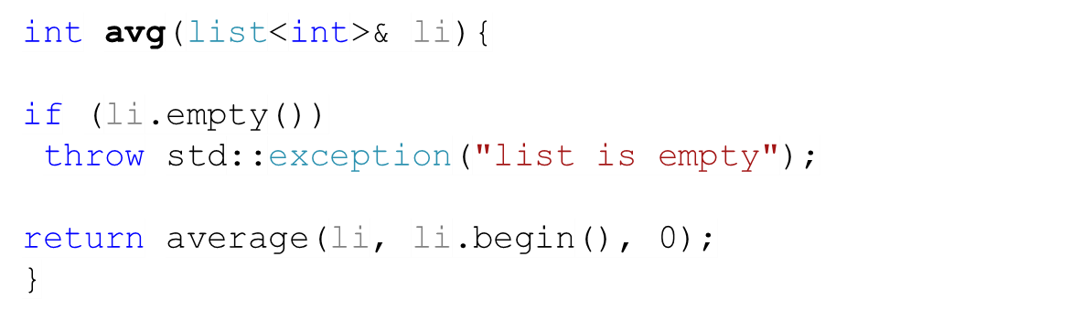


Solution
Not in the book
NULL
3
5
1
NULL
Wrapper function
9/3 = 3

Slide 18
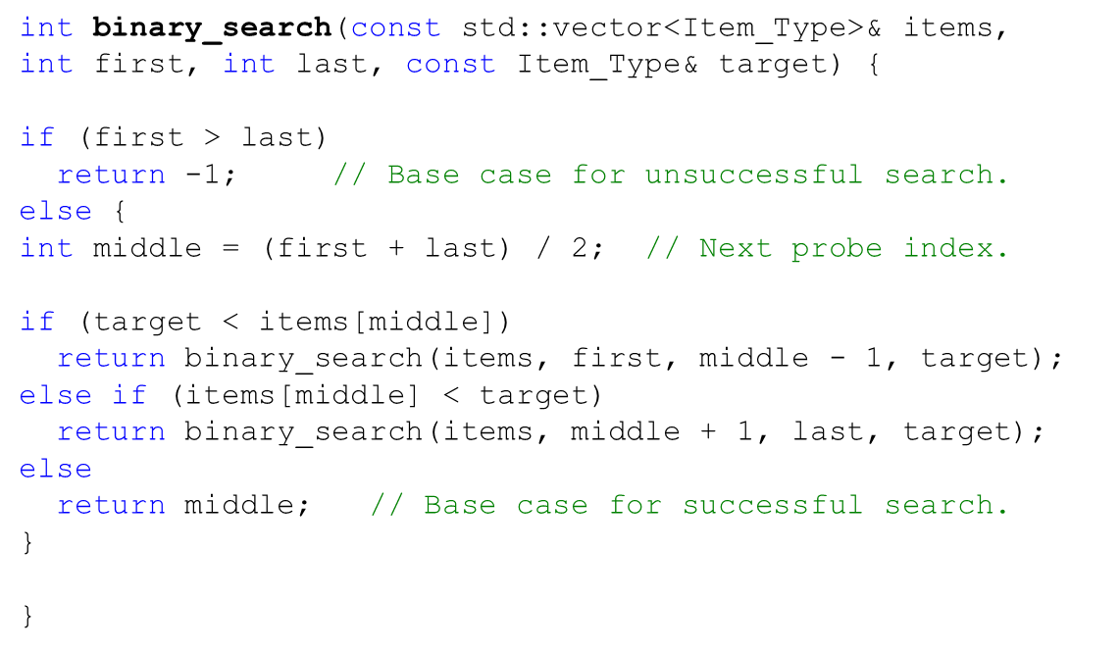
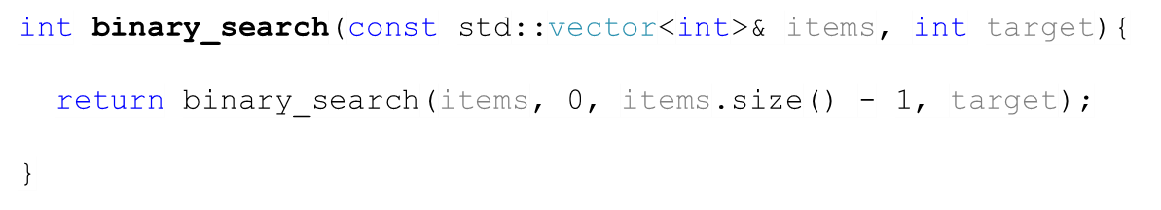
Binary Search - Recursive
first
middle
last
33
0 | 1 | 2 | 3 | 4 | 5 | 6 | 7 | 8
3 | 12 | 21 | 33 | 44 | 64 | 70 | 88 | 90
first
middle
last
0 | 1 | 2 | 3 | 4 | 5 | 6 | 7 | 8
3 | 12 | 21 | 33 | 44 | 64 | 70 | 88 | 90
first, middle
last
0 | 1 | 2 | 3 | 4 | 5 | 6 | 7 | 8
3 | 12 | 21 | 33 | 44 | 64 | 70 | 88 | 90
Wrapper function
first, middle, last
0 | 1 | 2 | 3 | 4 | 5 | 6 | 7 | 8
3 | 12 | 21 | 33 | 44 | 64 | 70 | 88 | 90

Slide 19
Task – Anagrams
Not in the book
A permutation is an arrangement of things in a definite order. Suppose you want to list all the arrangement of a specified word that can be made from the letters of the original word. We’ll call this anagramming a word. Anagramming cat, for example, would produce:
cat
cta
atc
act
tca
tac
Write a recursive function that generates all the possible permutation of a string
Notice that the number of possibilities is the factorial of the number of letters

Slide 20
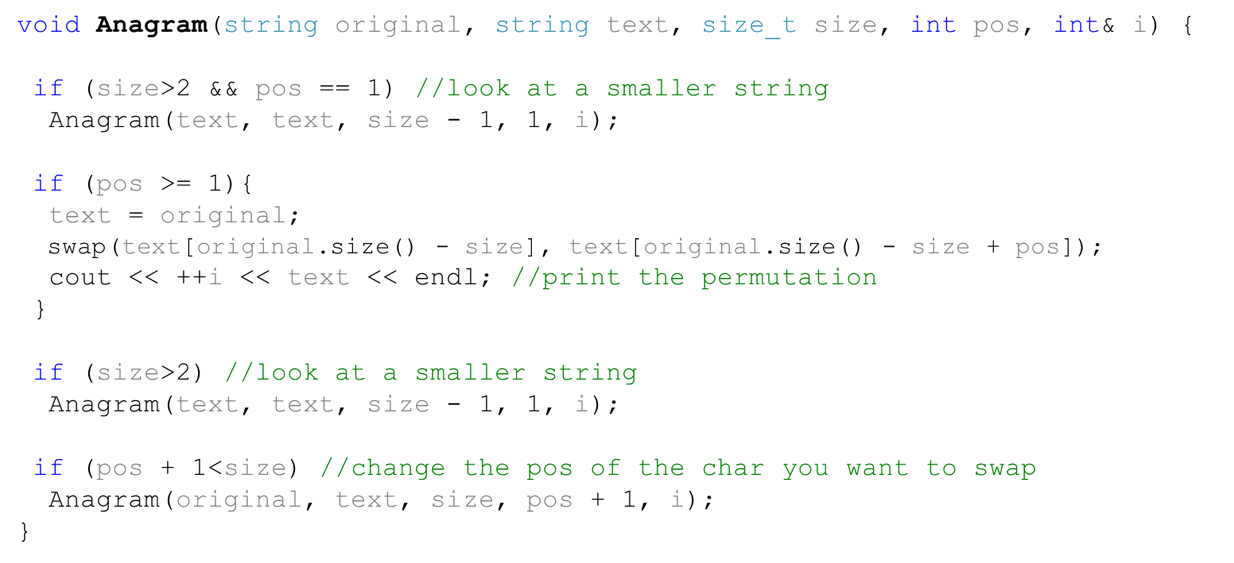
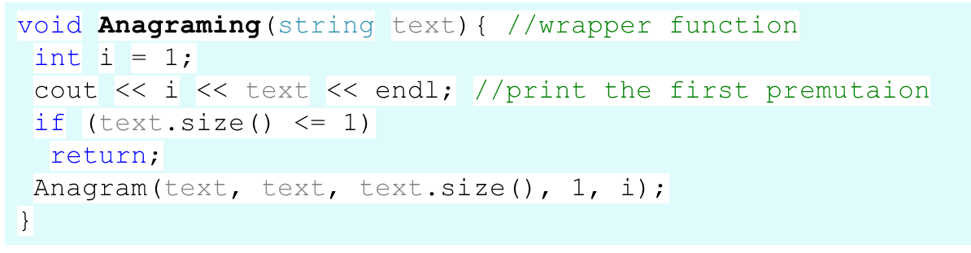
Solution
Not in the book
0 | 1 | 2
a | b | c
0 | 1 | 2
a | c | b
0 | 1 | 2
a | b | c
0 | 1 | 2
b | a | c
0 | 1 | 2
b | a | c
0 | 1 | 2
b | c | a
0 | 1 | 2
a | b | c
0 | 1 | 2
c | b | a
0 | 1 | 2
c | b | a
0 | 1 | 2
c | a | b

Slide 21
Task – Fastest Route
Not in the book
A driver needs to deliver goods to four different locations (A, B, C, D). He will start from point M.
You have information about the time it takes to get from one point to another (e.g. from point A to point B, M to C, B to M, etc.)
Write an algorithm that finds the fastest route for the driver. Assuming the driver starts from point M.
Disregard all the other factors (e.g. traffic)
A
M
B
C
D

Slide 22
Towers of Hanoi
The goal of the game is to move the three disks from the peg where they have been placed provided:
- Only the top disk on a peg can be moved to another peg.
- A larger disk cannot be placed on top of a smaller disk.
L
M
R

Slide 23
Solution to a 2-Disk Problem
1. Move the top disk from peg L to peg M.
2. Move the bottom disk from peg L to peg R.
3. Move the top disk from peg M to peg R.
L
M
R

Slide 24
Solution to a 3-Disk Problem
1. Move the top two disks from peg L to peg M.
2. Move the bottom disk from peg L to peg R.
3. Move top two disks from peg M to peg R.
L
M
R

Slide 25
Solution to a 4-Disk Problem
1. Move the top three disks from peg L to peg M.
2. Move the bottom disk from peg L to peg R.
3. Move the top three disks from peg M to peg R.
L
M
R

Slide 26
Towers of Hanoi - Algorithm
move(n, src, dst, tmp) =
if n == 1: move disk 1 from src to dst
otherwise:
move(n-1, src, tmp, dst)
move disk n from src to dst
move(n-1, tmp, dst, src)
L
M
R

Slide 27
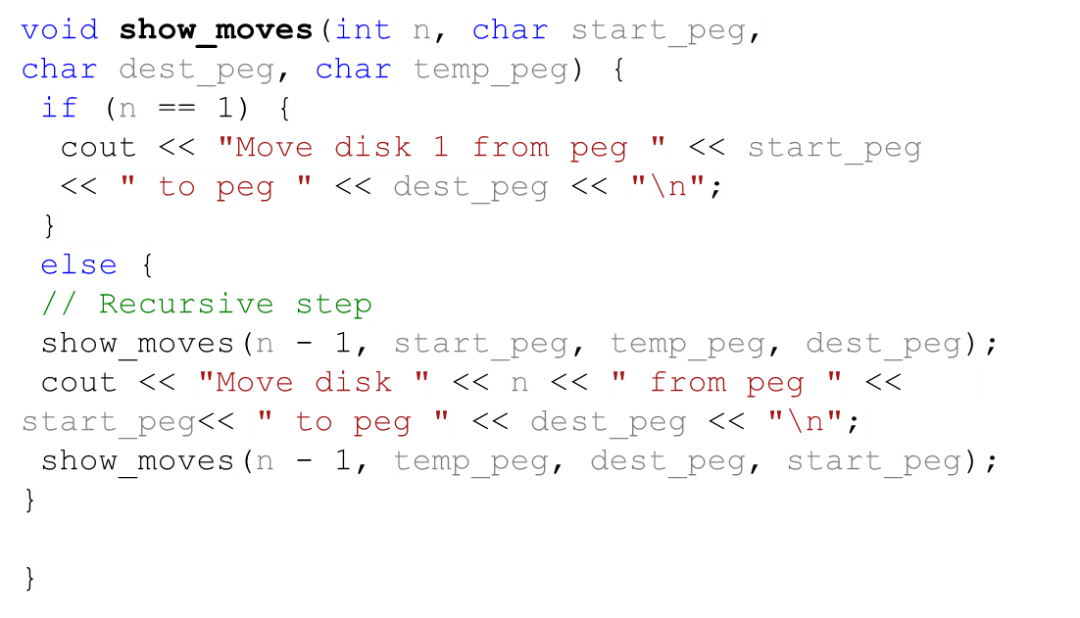
Towers of Hanoi - Algorithm
show_moves(3,L,R,M)
show_moves(2,L,M,R)
show_moves(1,L,R,M)
show_moves(2,M,R,L)
show_moves(1,R,M,L)
Called
show_moves(1,M,L,R)
Made the move
show_moves(1,L,R,M)
What is the performance?
L
M
R

Slide 28

Backtracking
What would you do if you were in a maze?
Try all the possibilities till you find an exist
Recursion implements backtracking straightforwardly
  Activation frame remembers choice made at that decision point

Slide 29

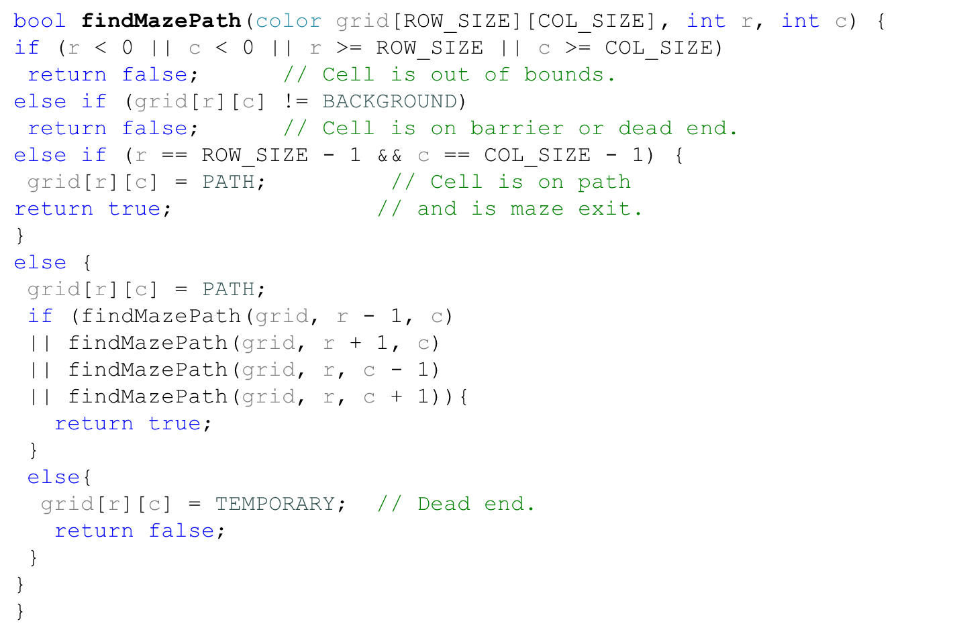
Backtracking Algorithm
 | 0 | 1 | 2 | 3 | 4
0
1
2
3
4 |  |  |  |  | EXIST
Path
Background
Dead End
Abnormal (wall)

Slide 30

Task
Not in the book
 | 0 | 1 | 2 | 3 | 4 | 5 | 6 | 7
0
1
2
3
4
5
6
7
Write a recursive function for placing eight queens on a chessboard. The eight queens should be placed so that no queen can capture another. Recall that a queen can move in the horizontal, vertical, or diagonal direction.

Slide 31
Checking if two queens can’t attack each other
Not in the book
 | 0 | 1 | 2 | 3 | 4 | 5 | 6 | 7
0
1
2
3
4
5
6
7
row[i] - row[j] == (i - j)
row[i] - row[j] == (j - i)
row[i] == row[j]

Slide 32
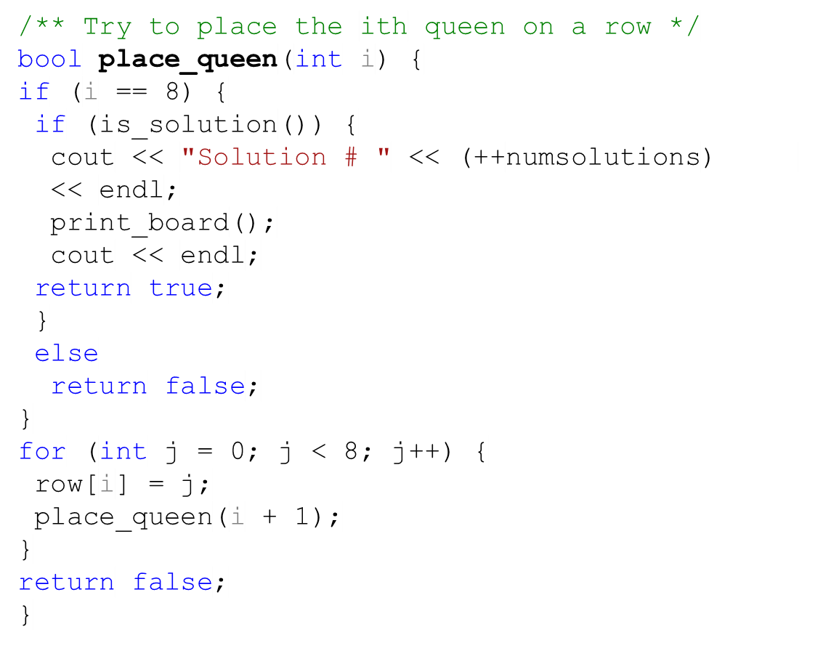
Task – Solution (1)
Not in the book
 | 0 | 1 | 2 | 3 | 4 | 5 | 6 | 7
0
1
2
3
4
5
6
7

Slide 33
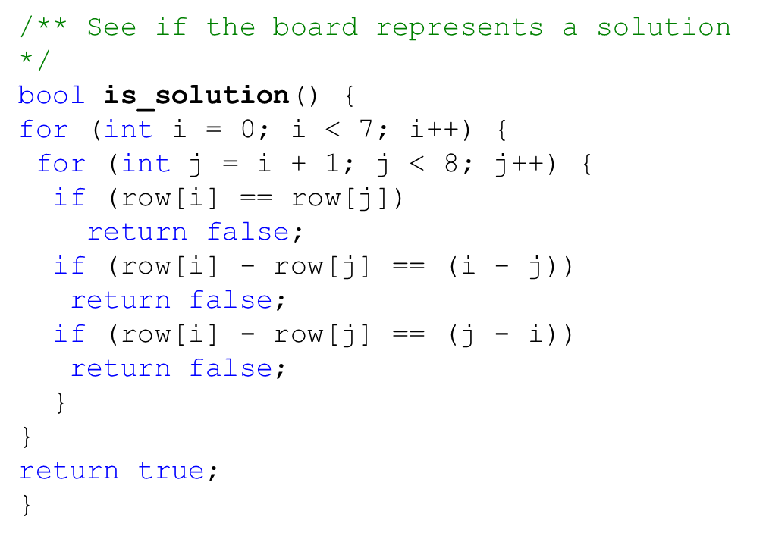
Task – Solution (2)
Not in the book
 | 0 | 1 | 2 | 3 | 4 | 5 | 6 | 7
0
1
2
3
4
5
6
7

Slide 34


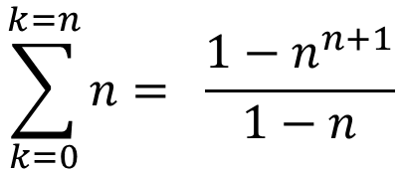
Task – Performance
Not in the book
 | 0 | 1 | 2 | 3 | 4 | 5 | 6 | 7
0
1
2
3
4
5
6
7

